Slide 1
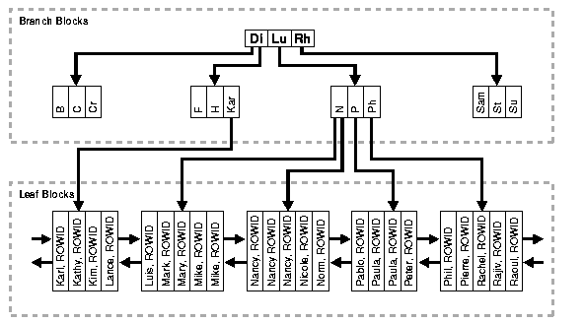
Oracle Internal Structure of a B-tree Index

Slide 2
B+ trees
The upper blocks ( branch blocks) of a B-tree index contain index data that points to lower-level index blocks
The lowest level index blocks (leaf blocks) contain every indexed data value and a corresponding rowid used to locate the actual row.

Slide 3
Indexing
Oracle provides several indexing schemes, which provide complementary performance functionality:
B-tree indexes
B-tree cluster indexes
Hash cluster indexes
Reverse key indexes
Bitmap indexes
Bitmap Join Indexes

Slide 4
Oracle function-based indexes
Function-based indexes
Function-based indexes defined on UPPER(column_name) or LOWER(column_name) can facilitate case-insensitive searches. For example, the following index:
CREATE INDEX uppercase_idx ON employees (UPPER(first_name)); can facilitate processing queries such as this:
SELECT * FROM employees WHERE UPPER(first_name) = 'RICHARD';

Slide 5
Fully indexed table
Fully indexing a large table with a traditional B-tree index can be prohibitively expensive in terms of space

Slide 6
Advantages of B-tree Structure
All leaf blocks of the tree are at the same depth, so retrieval of any record from anywhere in the index takes approximately the same amount of time.
B-tree indexes automatically stay balanced.
All blocks of the B-tree are three-quarters full on the average.

Slide 7
Advantages of B-tree Structure
B-trees provide excellent retrieval performance for a wide range of queries, including exact match and range searches.
Inserts, updates, and deletes are efficient, maintaining key order for fast retrieval.
B-tree performance is good for both small and large tables and does not degrade as the size of a table grows.

Slide 8
Join index
An index on attributes from two or more relations from the same domain. Join index stores the pre-computed join values; therefore, improves the performance of the join query.

Slide 9
Clusters
Cluster is a group of 2 or more tables stored together, because they have common columns and are usually accessed together. They have related columns called the cluster key.
Oracle supports two types
  Indexed clusters
  Hash clusters

Slide 10
Bitmap indexes
Used for sparse columns (columns with a small number of possible values)
  D(c) |D(c)| = Card (D(c)) < small n
Bitmap index is a collection of bit vectors, one vector for each possible value.

Slide 11
Bitmap index Example
Rid | M | F
1 | 1 | 0
2 | 0 | 1
3 | 0 | 1
Rid | Patient_Id | Gender | Age | Name
1 | 908802 | M | 33 | Joe A.
2 | 788990 | F | 31 | Ann B.
3 | 99998 | F | 22 | Sue W.
Bitmap index
Patient table

